Slide 1


Market Intelligence data delivered by the Nielsen Portfolio
prepared for Myungin Baek from Innocean Seoul on 20/04/2020
"Understand the advertising around you to improve your own"

Slide 2
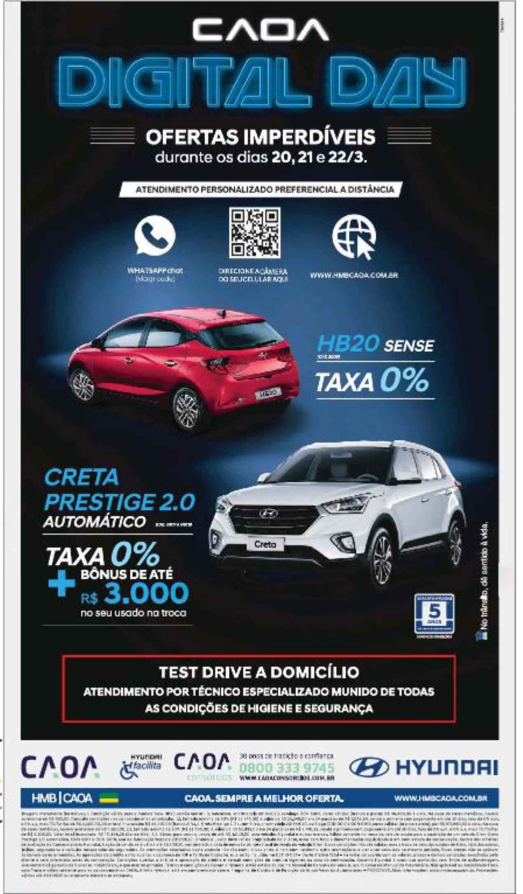
Hyundai Motors
Title: | Caoa digital day
Media: | Press
Description: | Offer - 0% interest. Savings.
Country: | Brazil
Product: | car range/corporate
Category (Full Hierarchy): | AUTOMOTIVE | Cars | Cars Corporate/Range
Duration: | 1 image/s
Date From/To: | 22/03/2020
Publication: | ESTADO DE SAO PAULO, O
Endline: | -
Creative ID: | 1248913601

Slide 3
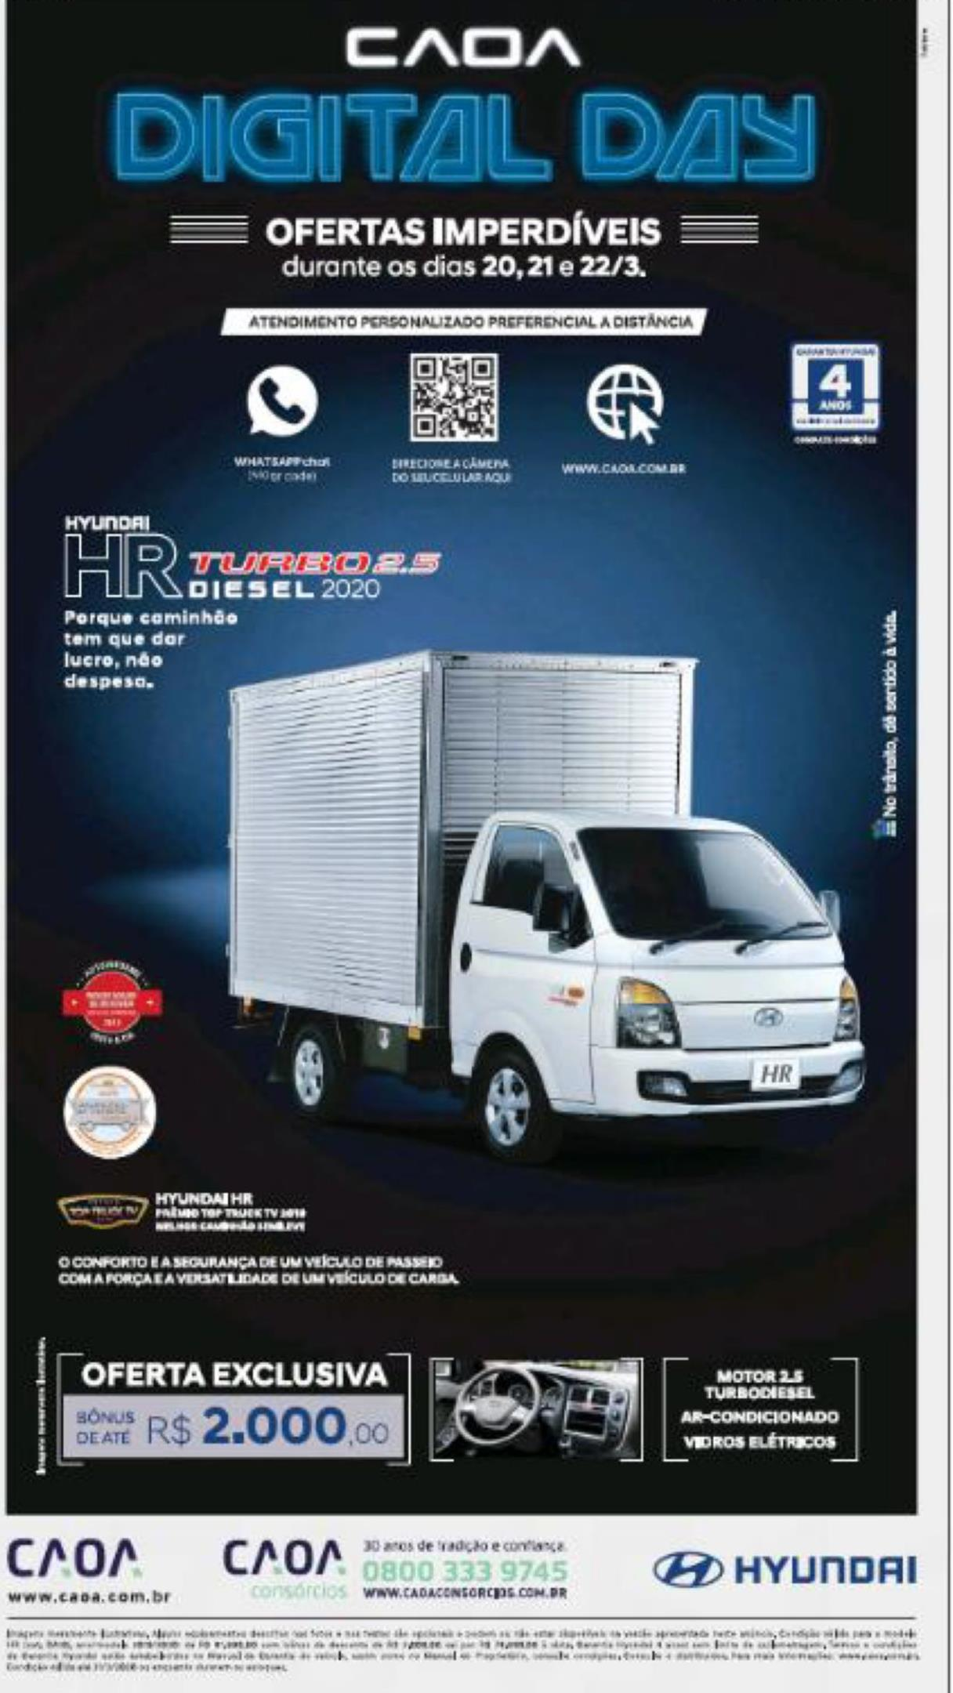
Hyundai Motors
Title: | Caoa digital day
Media: | Press
Description: | Savings. AWP.
Country: | Brazil
Product: | HR medium van
Category (Full Hierarchy): | AUTOMOTIVE | Commercial Vehicles | Commercial Vehicles <3.5 Tons (Medium)
Duration: | 1 image/s
Date From/To: | 22/03/2020
Publication: | FOLHA DE SAO PAULO
Endline: | -
Creative ID: | 1248915301

Slide 4
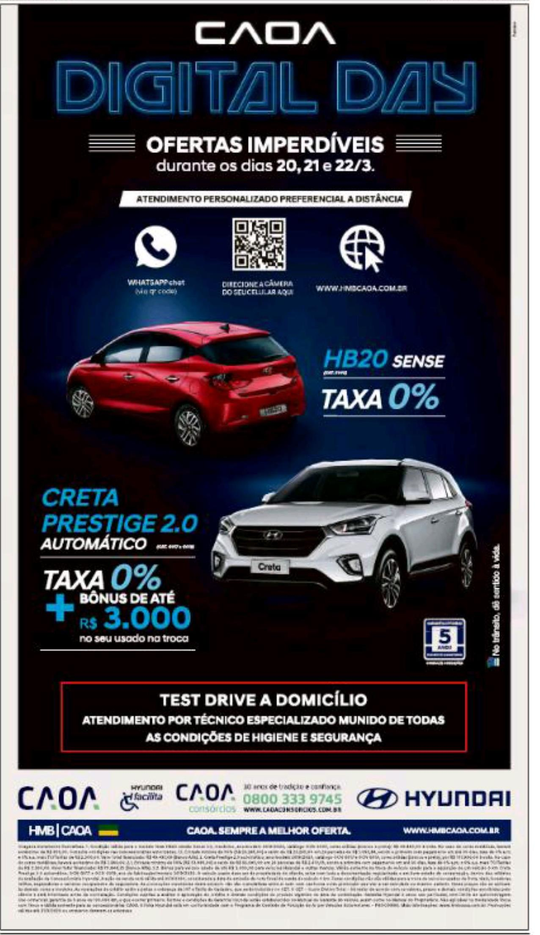
Hyundai Motors
Title: | Caoa Digital day
Media: | Press
Description: | 0% APR. AWP. Offer - bonus.
Country: | Brazil
Product: | vehicle range
Category (Full Hierarchy): | AUTOMOTIVE | Cars | Cars Corporate/Range;AUTOMOTIVE | Commercial Vehicles | Commercial Vehicles Corporate/Range
Duration: | 2 image/s
Date From/To: | 21/03/2020
Publication: | FOLHA DE SAO PAULO
Endline: | -
Creative ID: | 1249250301

Slide 5
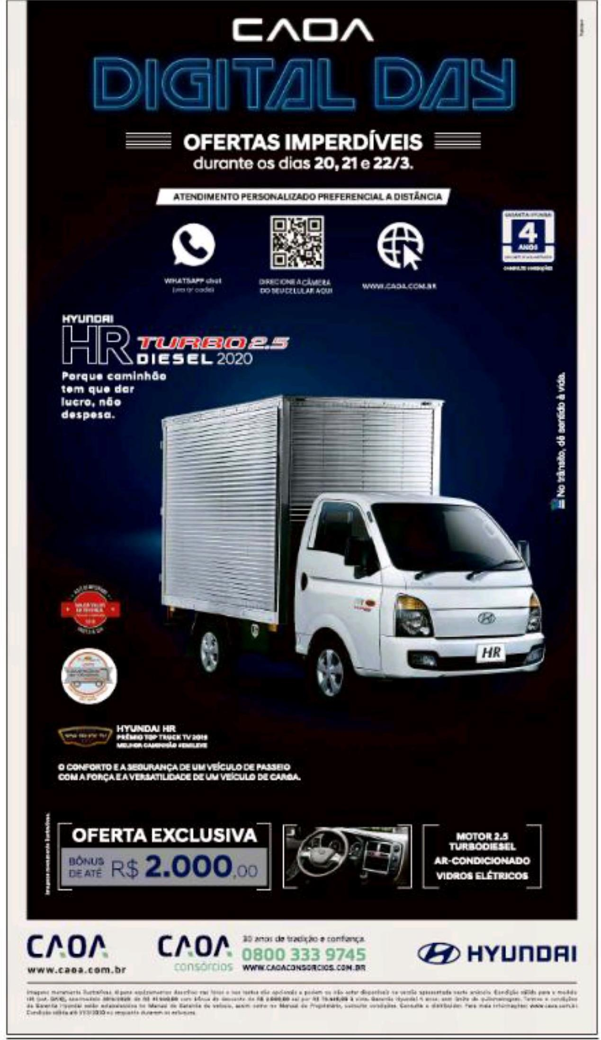

Slide 6
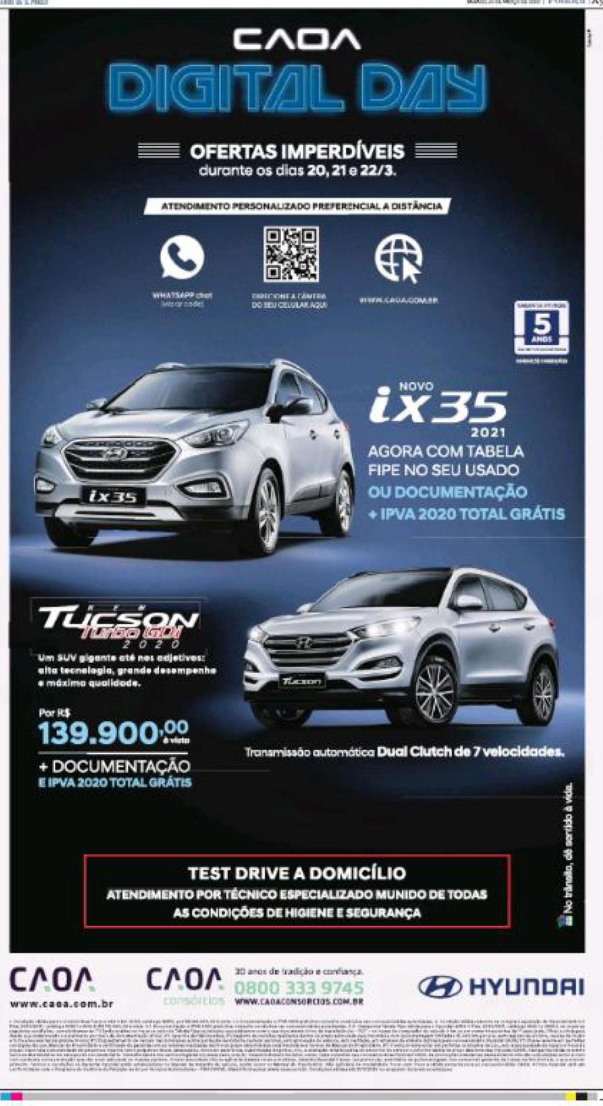
Hyundai Motors
Title: | Caoa digital day
Media: | Press
Description: | Offers - free documentation and 0% interest. Savings.
Country: | Brazil
Product: | car range/corporate
Category (Full Hierarchy): | AUTOMOTIVE | Cars | Cars Corporate/Range
Duration: | 2 image/s
Date From/To: | 21/03/2020
Publication: | ESTADO DE SAO PAULO, O
Endline: | -
Creative ID: | 1248913401

Slide 7
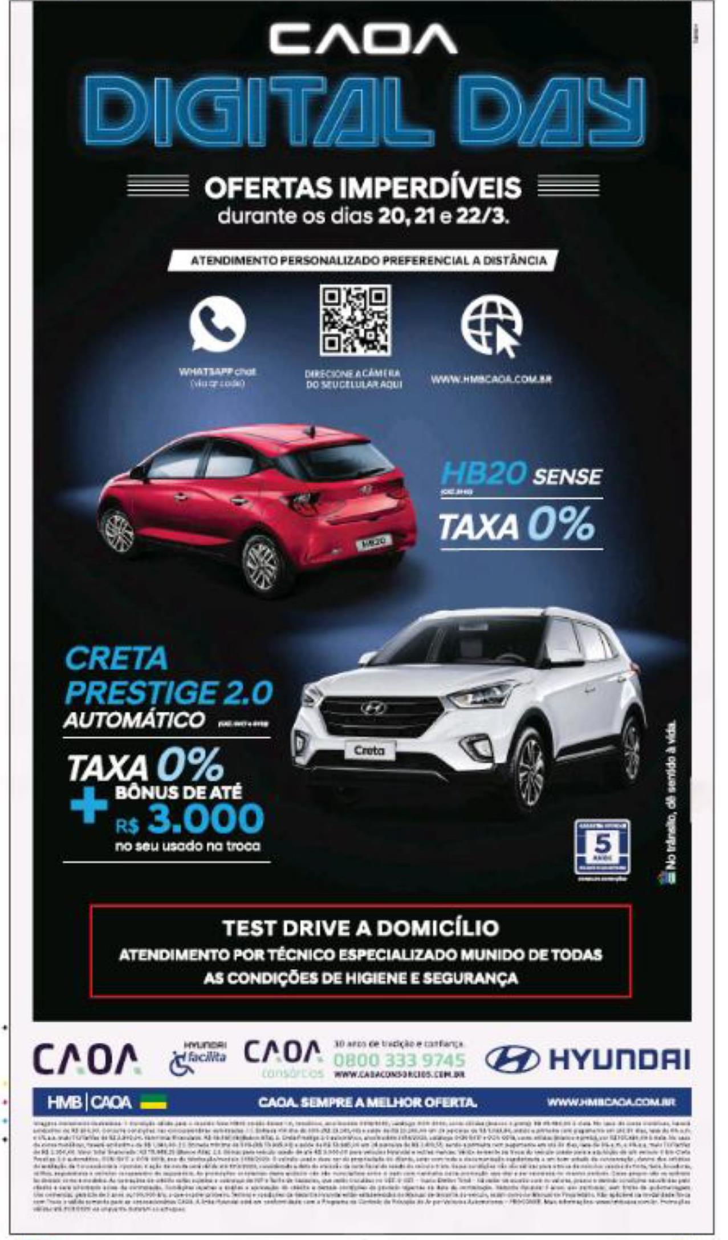

Slide 8

Hyundai Motors
Title: | Caoa digital day
Media: | Press
Description: | Offers - 0% finance and free documentation. Savings.
Country: | Brazil
Product: | car range/corporate
Category (Full Hierarchy): | AUTOMOTIVE | Cars | Cars Corporate/Range
Duration: | 2 image/s
Date From/To: | 20/03/2020
Publication: | FOLHA DE SAO PAULO
Endline: | -
Creative ID: | 1248910701

Slide 9
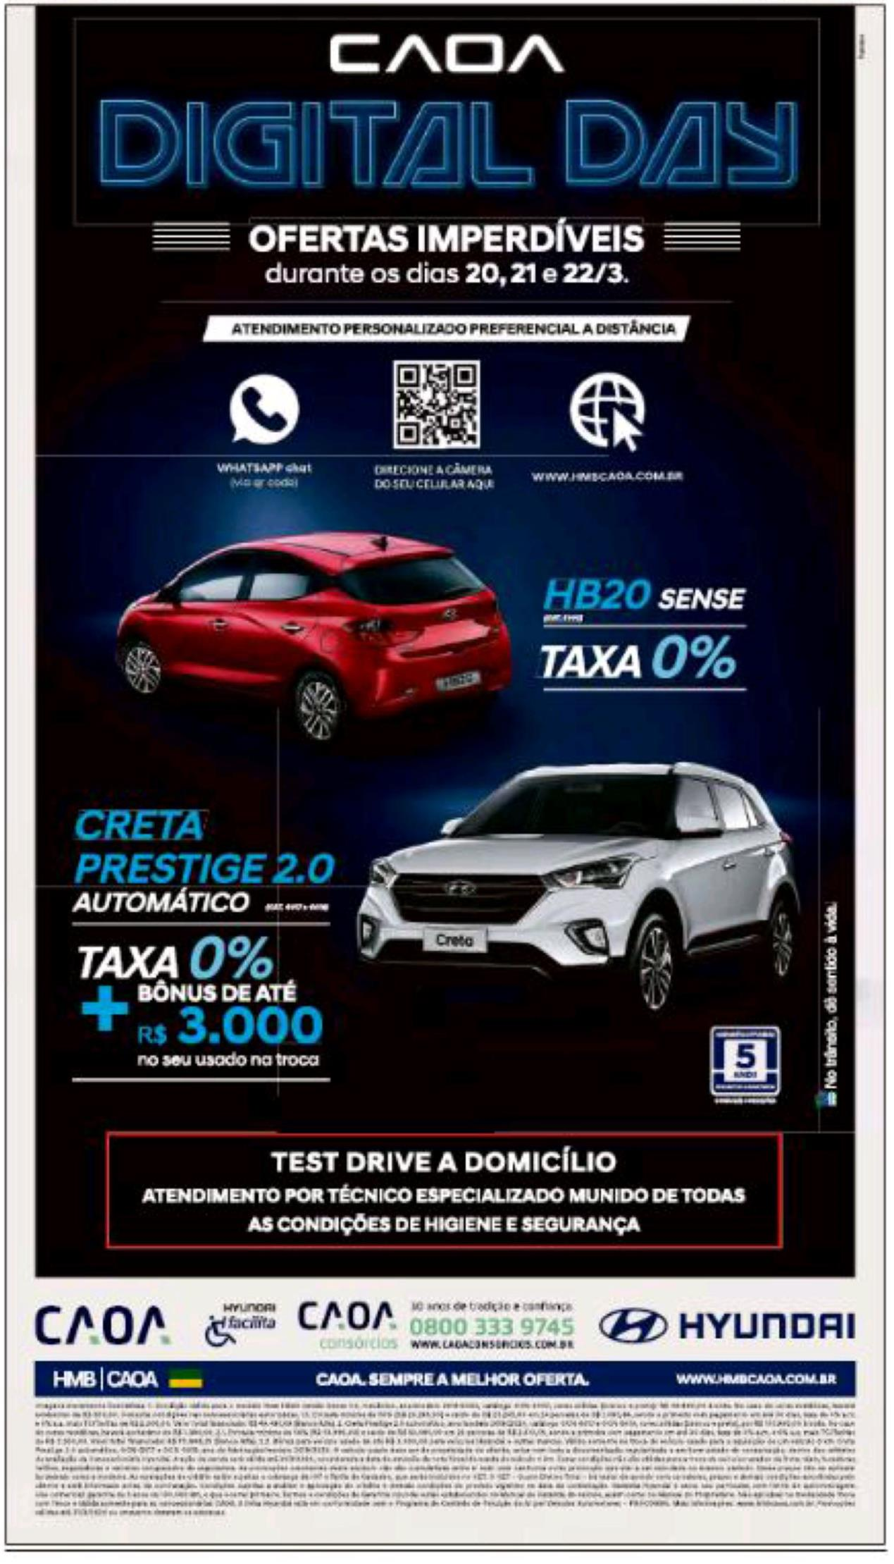

Slide 10
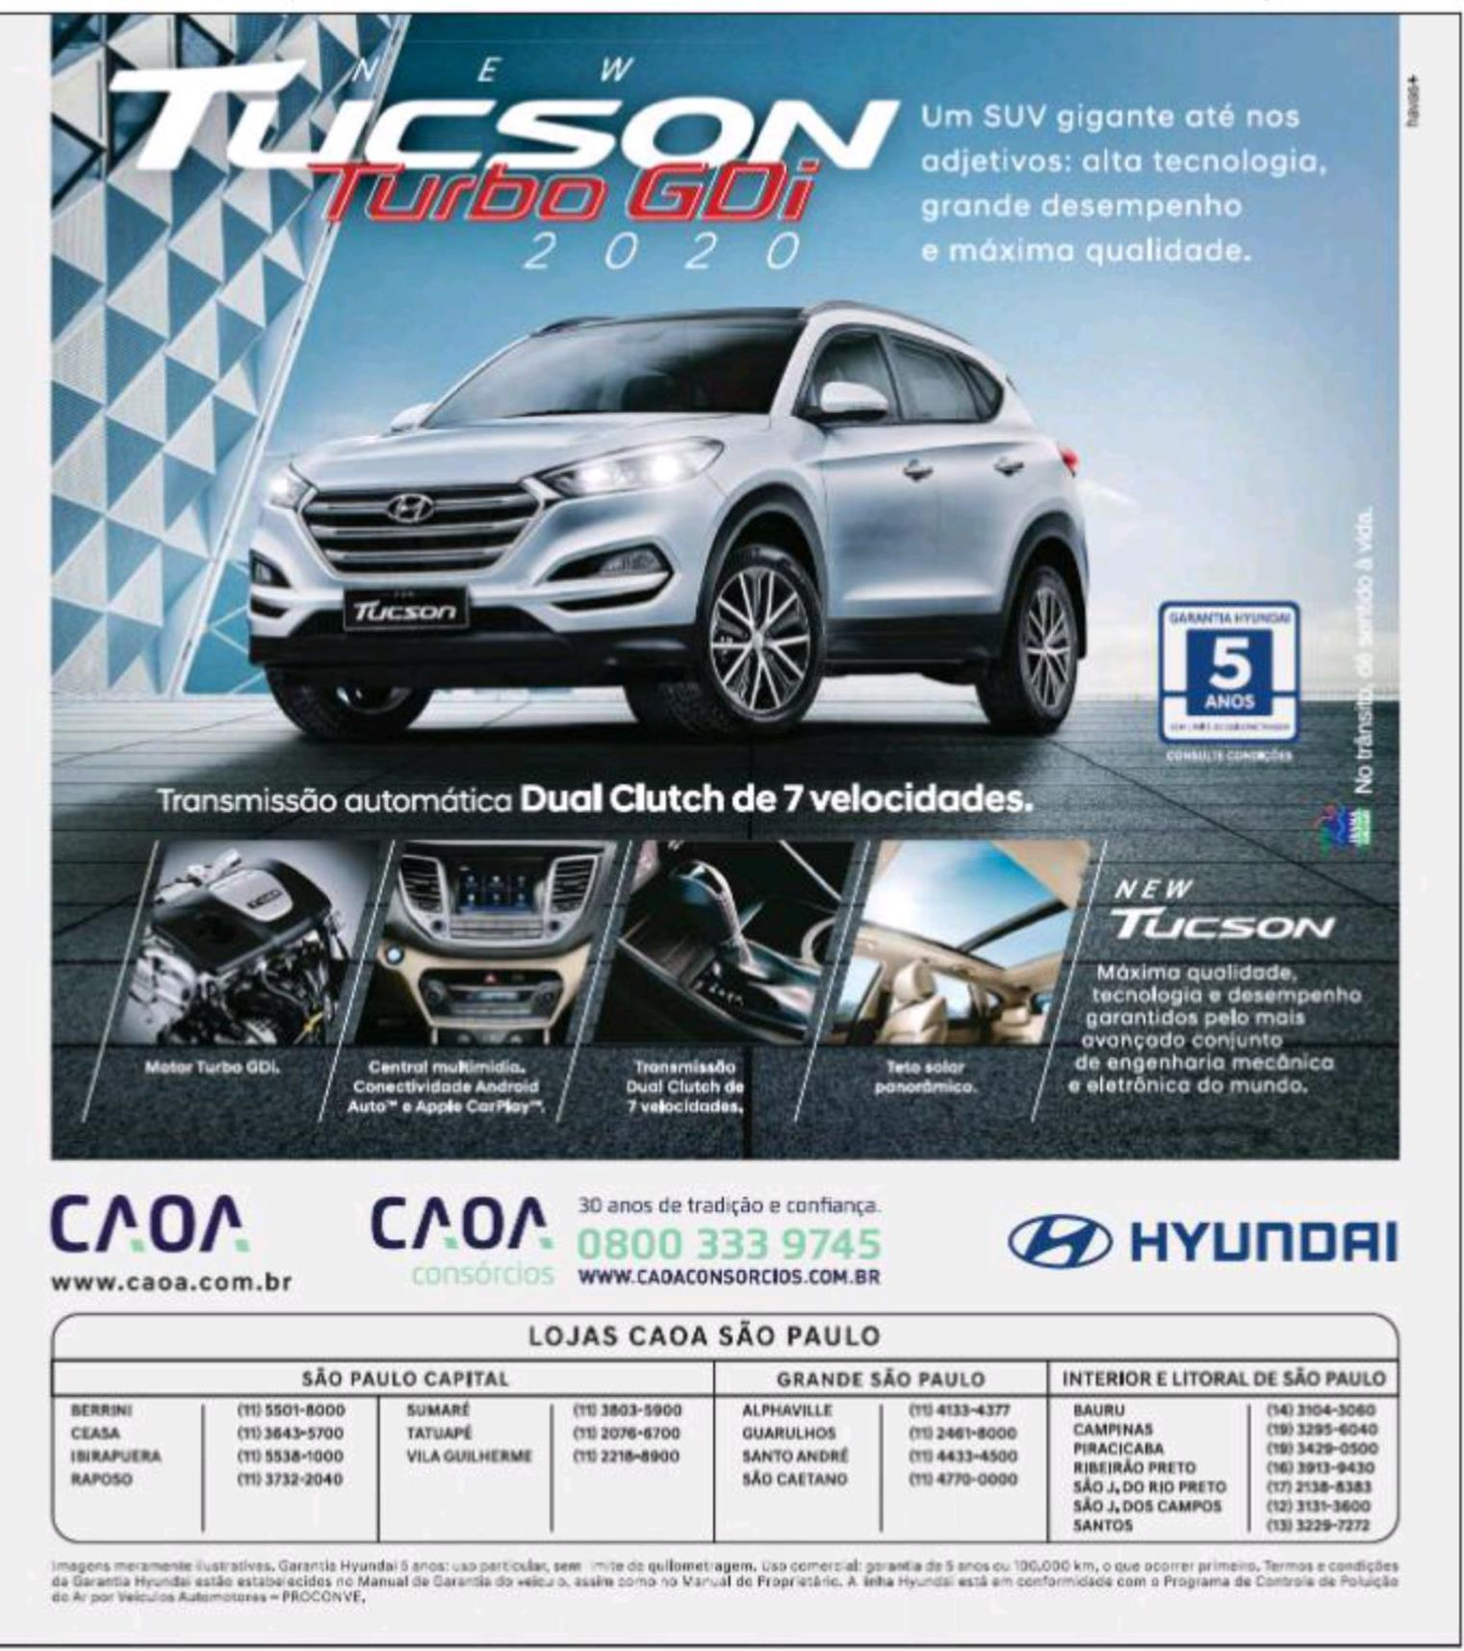
Hyundai Motors
Title: | New Tucson Turbo GDi 2020
Media: | Press
Description: | Images on car interior.
Country: | Brazil
Product: | Tucson offroader/SUV
Category (Full Hierarchy): | AUTOMOTIVE | Cars | Cars Offroad Vehicle/SUV/4x4
Duration: | 1 image/s
Date From/To: | 18/03/2020
Publication: | ESTADO DE SAO PAULO, O
Endline: | -
Creative ID: | 1248902001

Slide 11
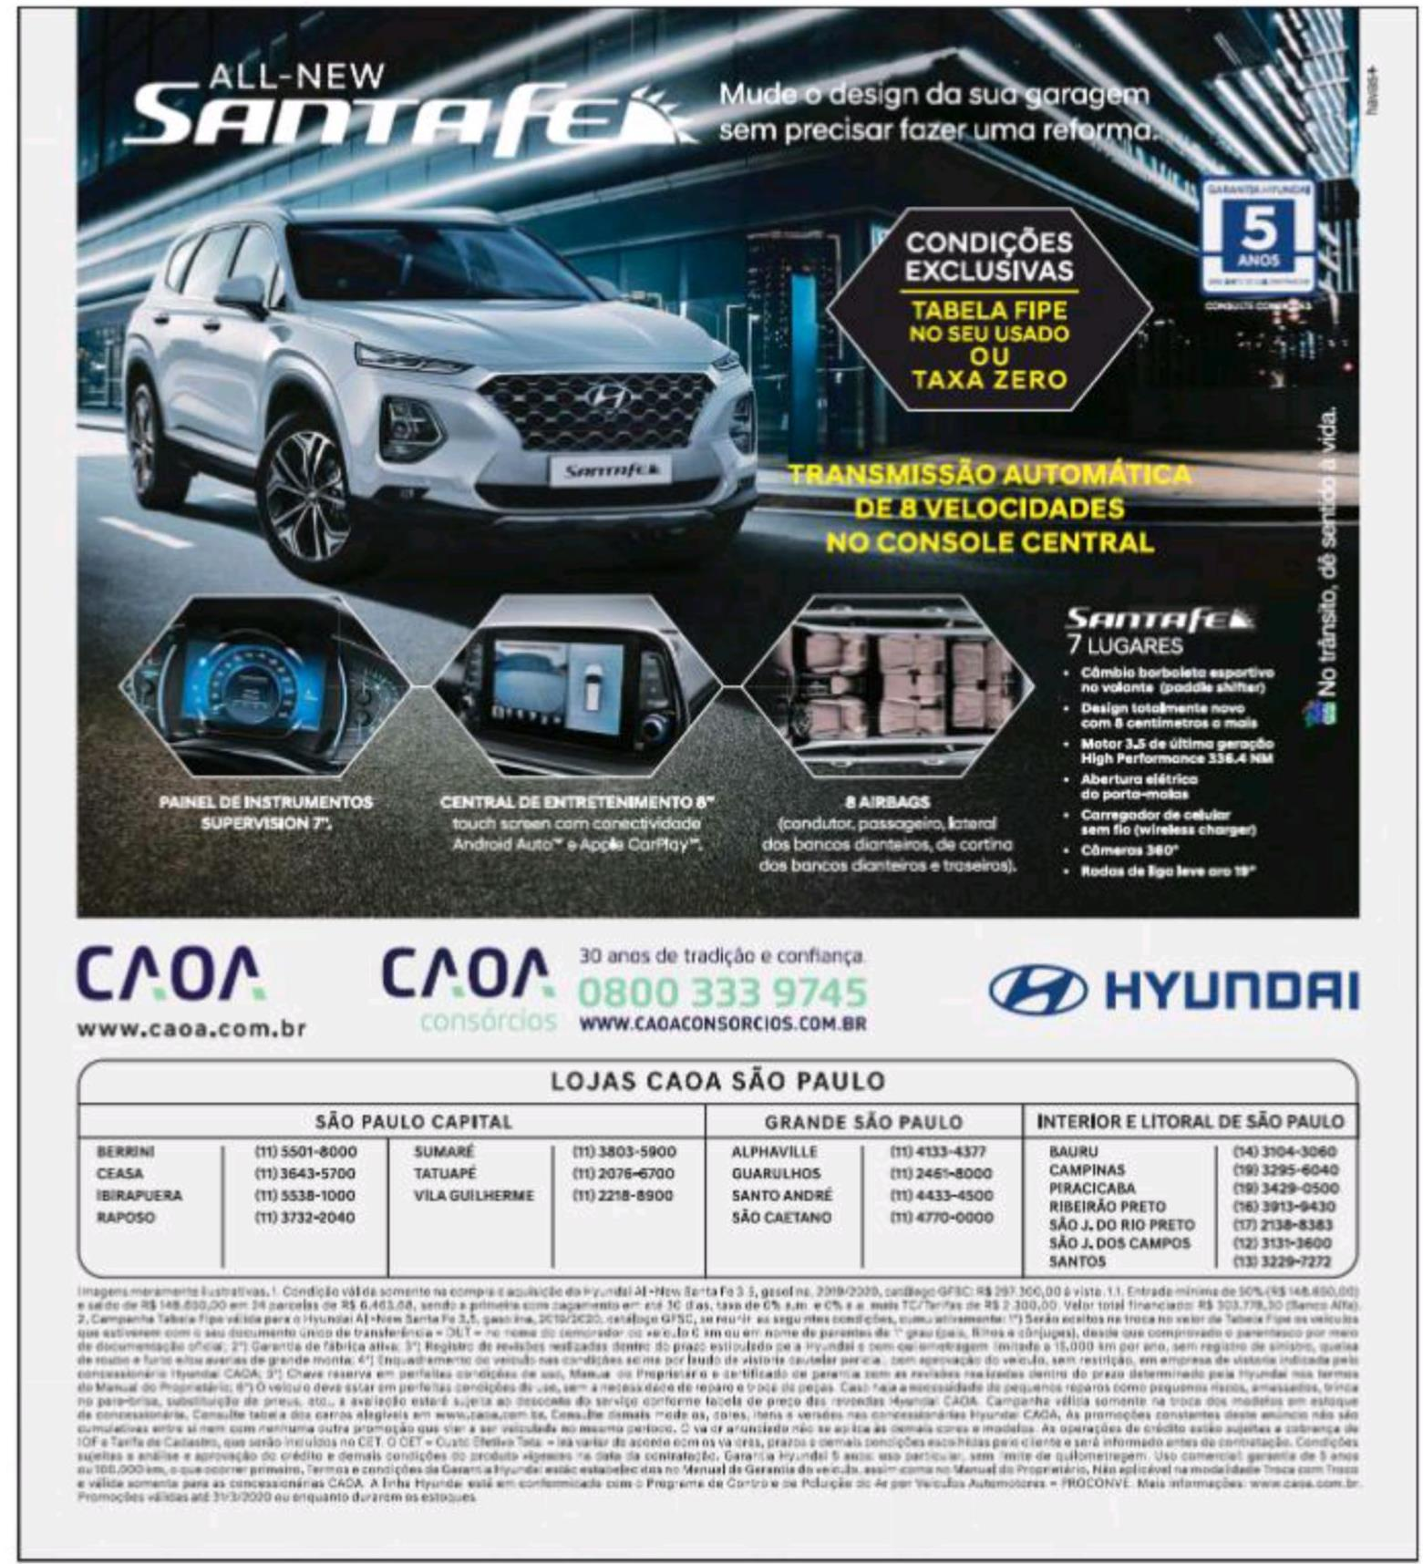
Hyundai Motors
Title: | All-new Santa Fe
Media: | Press
Description: | Images of car interior. Building at night.
Country: | Brazil
Product: | Santa Fe offroader/SUV
Category (Full Hierarchy): | AUTOMOTIVE | Cars | Cars Offroad Vehicle/SUV/4x4
Duration: | 1 image/s
Date From/To: | 18/03/2020
Publication: | ESTADO DE SAO PAULO, O
Endline: | -
Creative ID: | 1248902601

Slide 12
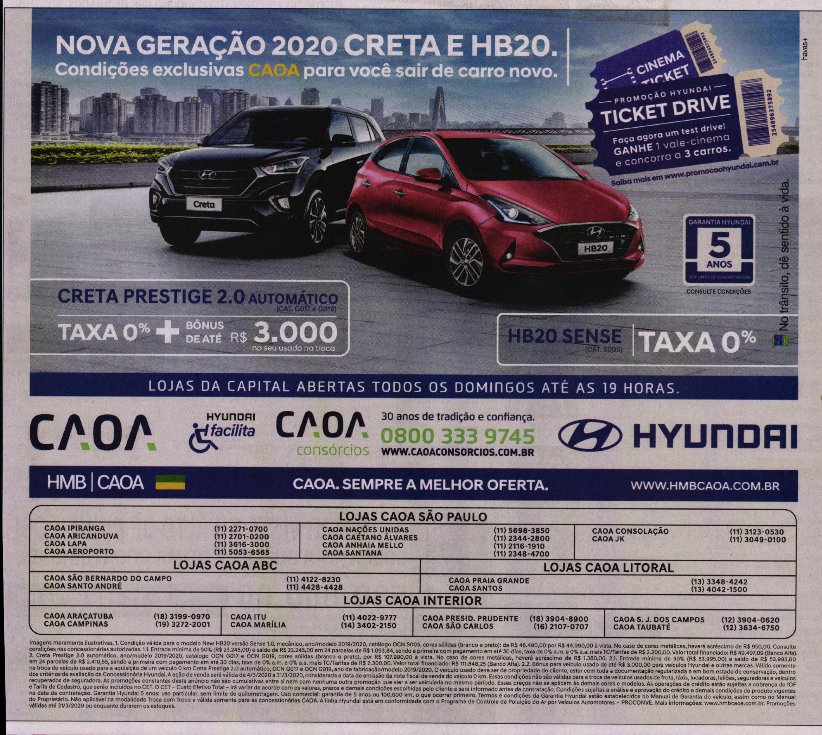
Hyundai Motors
Title: | Nova geracao 2020 Creta e HB20.
Media: | Press
Description: | City buildings. Offer: bonus, competition and cinema tickets. 0% APR.
Country: | Brazil
Product: | car range/corporate
Category (Full Hierarchy): | AUTOMOTIVE | Cars | Cars Corporate/Range
Duration: | 1 image/s
Date From/To: | 15/03/2020
Publication: | ESTADO DE SAO PAULO, O
Endline: | -
Creative ID: | 1245708801

